Slide 1
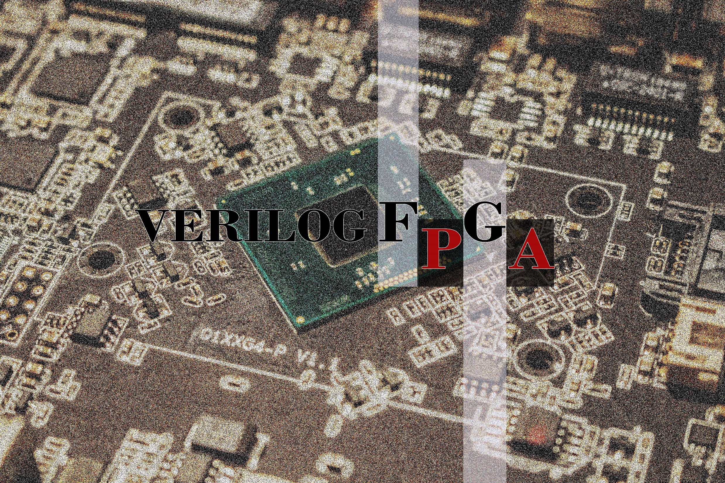
FATİH İLİĞ

Slide 2
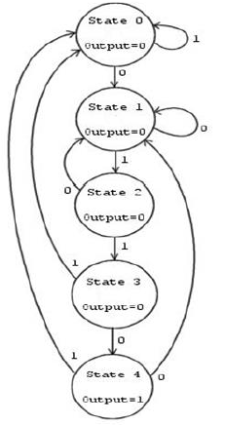
Finite State Machine
Sonlu durum makinası , sınırlı sayıda durumdan ve durumlar arası geçişlerden oluşan davranışların bir modelidir.

Slide 3
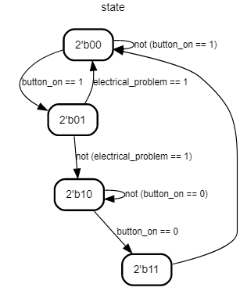

Slide 4
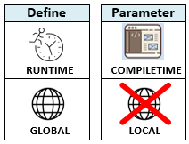
Parameter and Define Declarations
A ‘define’ is a macro, which is of global scope If you define in a module, it still stays declared after the module. After it is defined, is referenced using the macro name with a preceding ` (back-tic) character. It can exist either inside or outside of a module declaration, and both are treated the same way.It can be modified during runtime.
On the other hand, ‘parameter’ is local to a module. Parameter declarations can only be declared inside of module boundaries. After it is declared, it is referenced using the parameter name. It is used to define a property of the module. This property can be left to default, or can be modified at instantiation of the module. It is used to declare constants which are not modified during runtime.

Slide 5
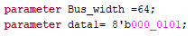

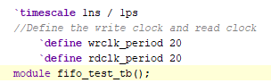

Parameter
A parameter, or constant, is useful for representing a quantity that will be used multiple times in the architecture.
Define

Slide 6
